Slide 1


Software Architecture - Principles and Practices Day 3
Mateusz Dymiński

Slide 2

Agenda

Slide 3
Agenda
DevOps culture
Continuous Integration/Delivery
GitOps/GitSecOps
Deployment models
Operations
Security

Slide 4

DevOps Culture

Slide 5
DevOps Culture
DevOps is a cultural shift
shared understanding between developers and operations
sharing responsibility for the software they build
No admins and devs siloes

Slide 6
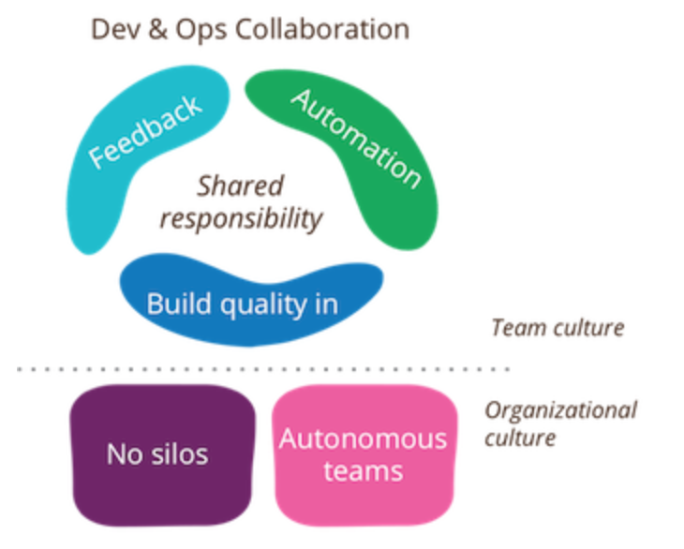
DevOps Culture

Slide 7
DevOps Culture
Autonomous teams
Shared responsibility
No strict split into devs and admins
Building quality into the development process
No commit and forget
Automation
Automate everything
Feedback
No siloes – ops and dev teams should send feedback immediately

Slide 8
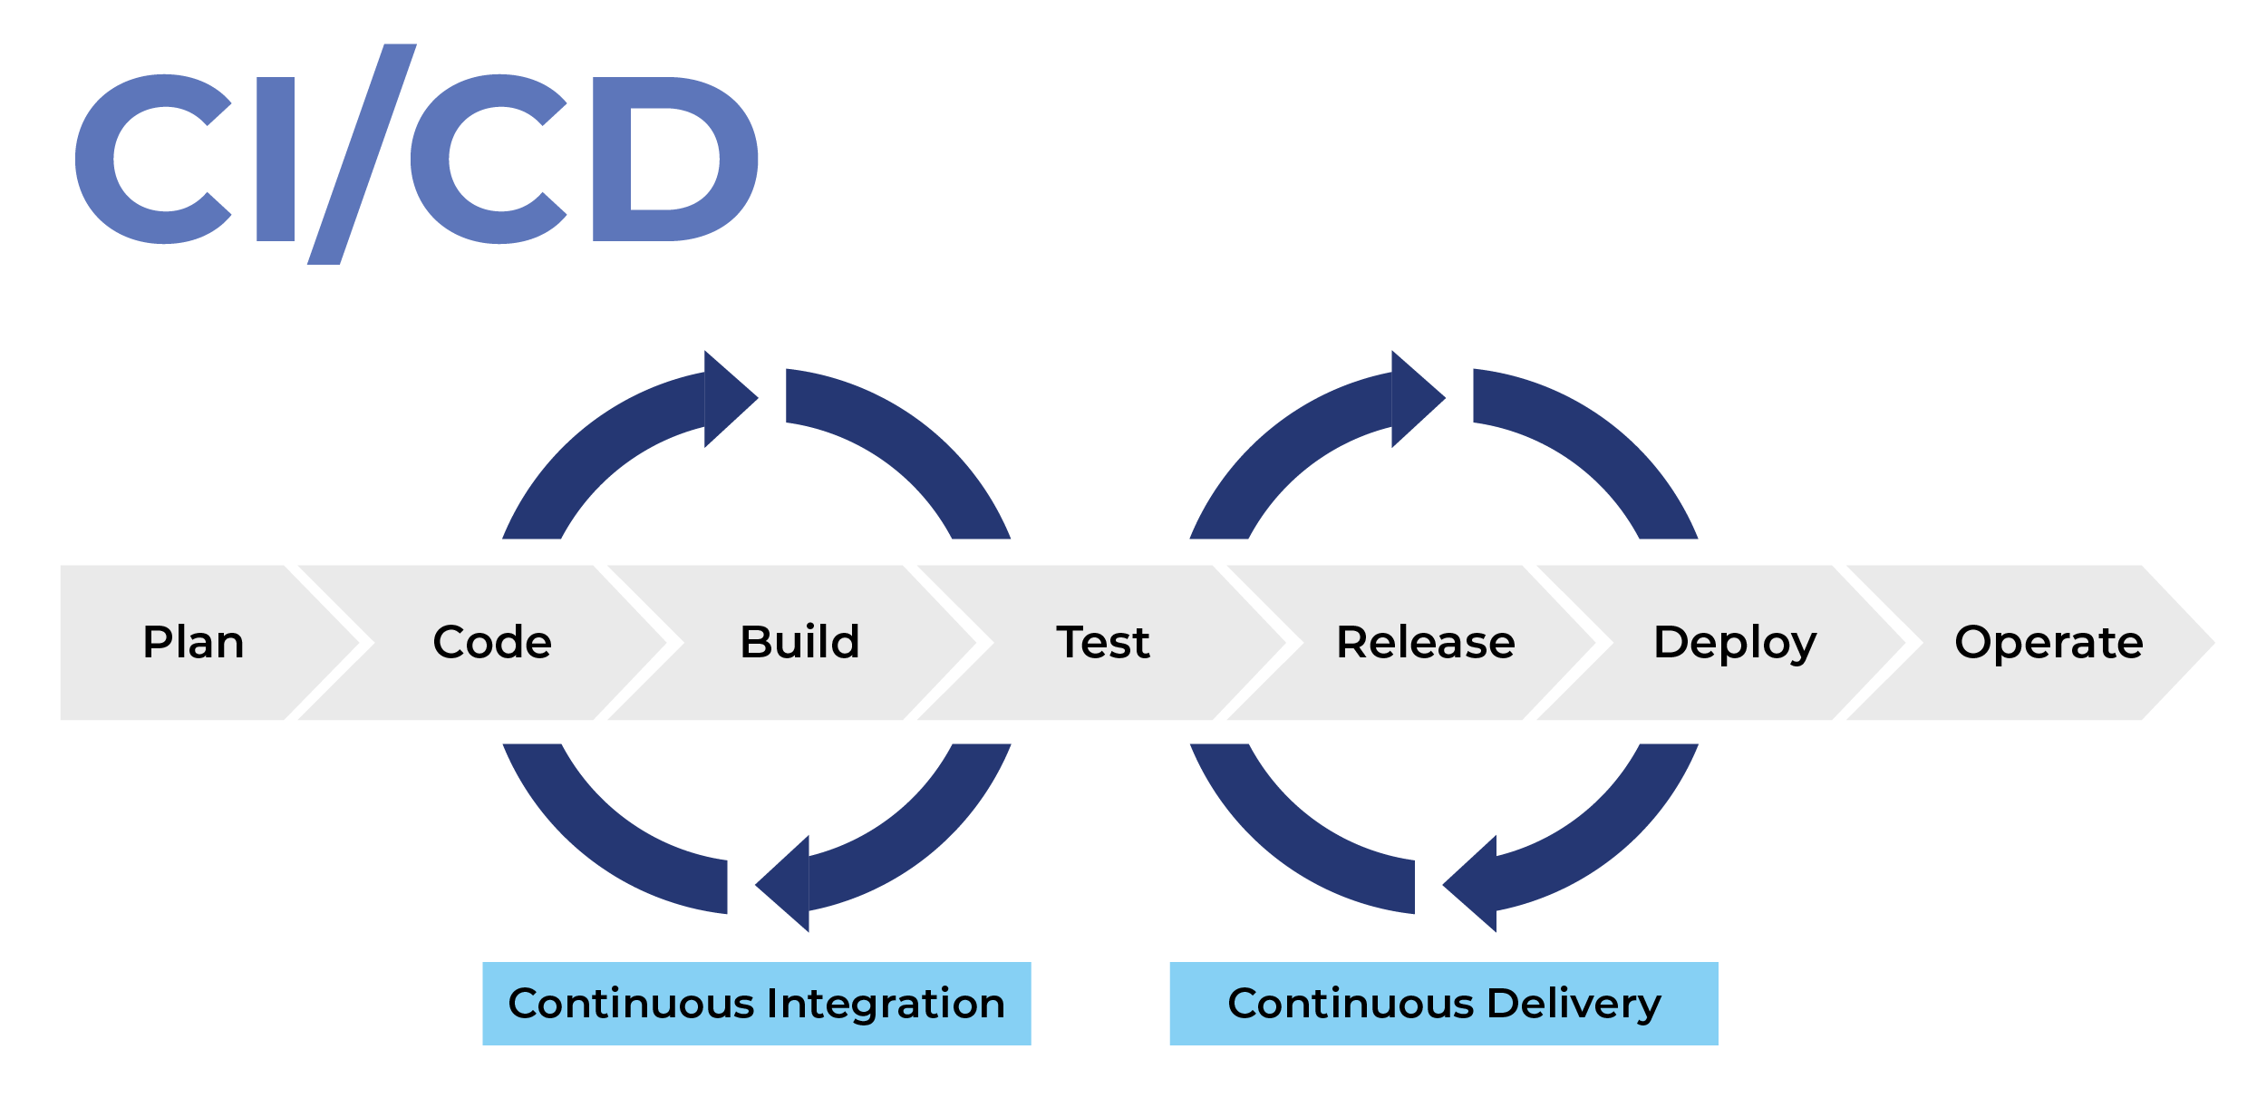

Slide 9
Continuous Integration and Continuous Delivery
CI/CD or CICD is the combined practices of continuous integration (CI) and either continuous delivery or continuous deployment (CD)

Slide 10
Continuous Integration
Run pipeline every commit
Pipeline should (at least) contains following phases:
Build
Test
Release
Test with “Fail fast” approach
Isolation
Artifacts
Promotion

Slide 11
Continuous Integration - characteristics
As fast as possible
Stable
Clean - should notify dev when failed

Slide 12
Continuous deployment
CI first. After the CI is proved to be reliable, move on to set up the CD part
Not easy
Non-production env first
Additional concepts need to be implemented to make it work
Automated tests
Promotion
Monitoring*
Smoke tests
Deployment rollout*
Deployment rollback*
Zero downtime deployments*
Graceful shutdown*
* Will cover these topics later on

Slide 13
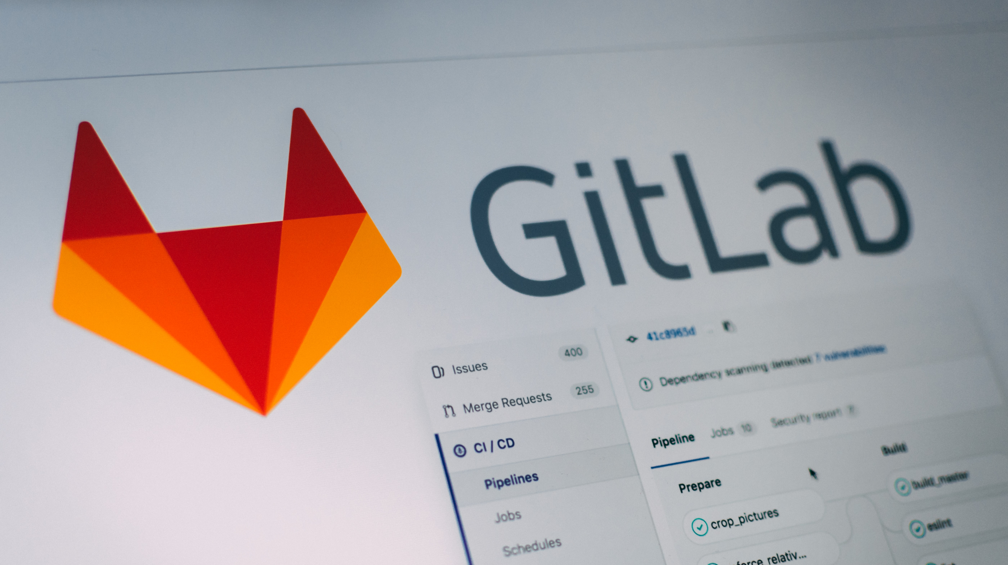
GitOps

Slide 14
GitOps
GitOps can be summarized as:
A path towards a developer experience for managing applications; where end-to-end CICD pipelines and Git workflows are applied to both operations, and development.

Slide 15
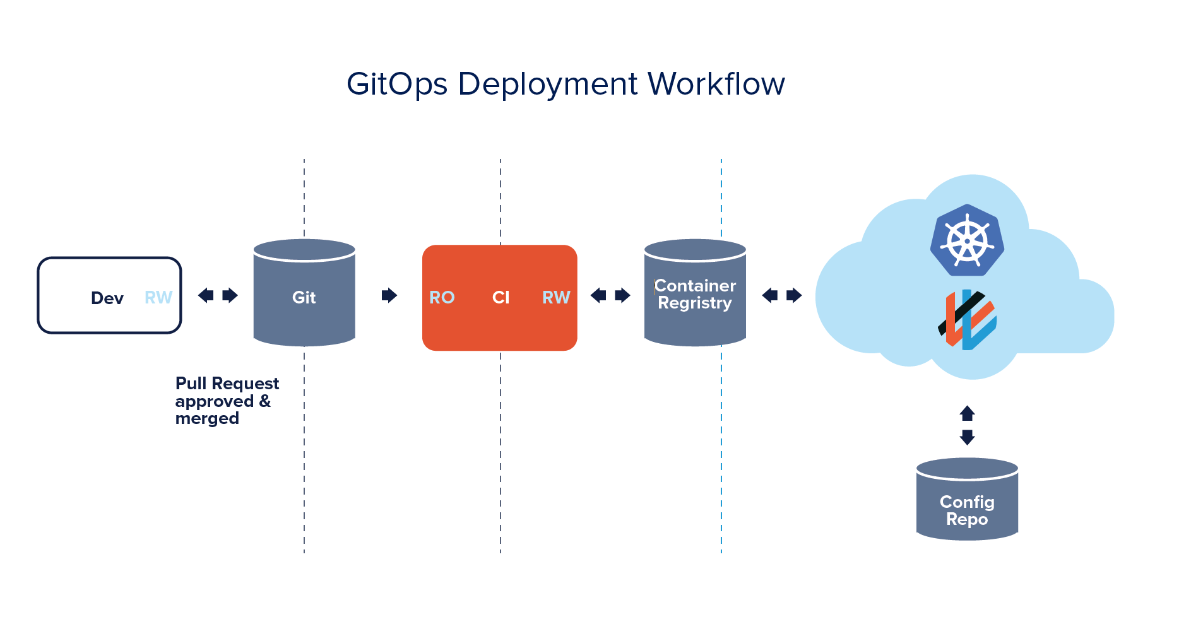
GitOps
Source: https://www.weave.works/technologies/gitops/

Slide 16
GitOps - rules
#1. The entire system described declaratively.
#2. The canonical desired system state versioned in Git.
#3. Approved changes that can be automatically applied to the system.
#4. Software agents to ensure correctness and alert on divergence.
Source: https://www.weave.works/technologies/gitops/

Slide 17
GitOps - benefits
Increased Productivity
Enhanced Developer Experience
Improved Stability
Higher Reliability
Consistency and Standardization
Stronger Security Guarantees
Source: https://www.weave.works/technologies/gitops/

Slide 18
GitSecOps

Slide 19
GitSecOps
GitOps + Security
Automated Security during CI
CI security capabilities:
Static Application Security Testing (SAST, all tiers)
Dynamic Application Security Testing (DAST)
Dependency Scanning
Container Scanning
License Compliance
Fuzz testing
Will cover that later on

Slide 20

Deployment Models

Slide 21
CI/CD
Already covered

Slide 22

Zero-downtime deployments

Slide 23
What is this zero downtime deployment?
Deploy application to production
End user can’t notice any errors/problems during the deployment
Monitoring tools shouldn’t even notice that deployment is ongoing/done
Bugs can be fixed without any outage.
New features can be introduced without any outage.
Required for Continuous Delivery - CD

Slide 24
Zero downtime deployment types
Rolling Updates deployment
Blue/Green deployment
Canary deployment

Slide 25
Rolling Update Deployment
Rolling Update deployment is when you run new version of the application next to the old one
Have proxy or load balancer in front of your applications
One by one new application is deployed and old one is shutdown
Problem – client needs handle old and new application in the same time

Slide 26
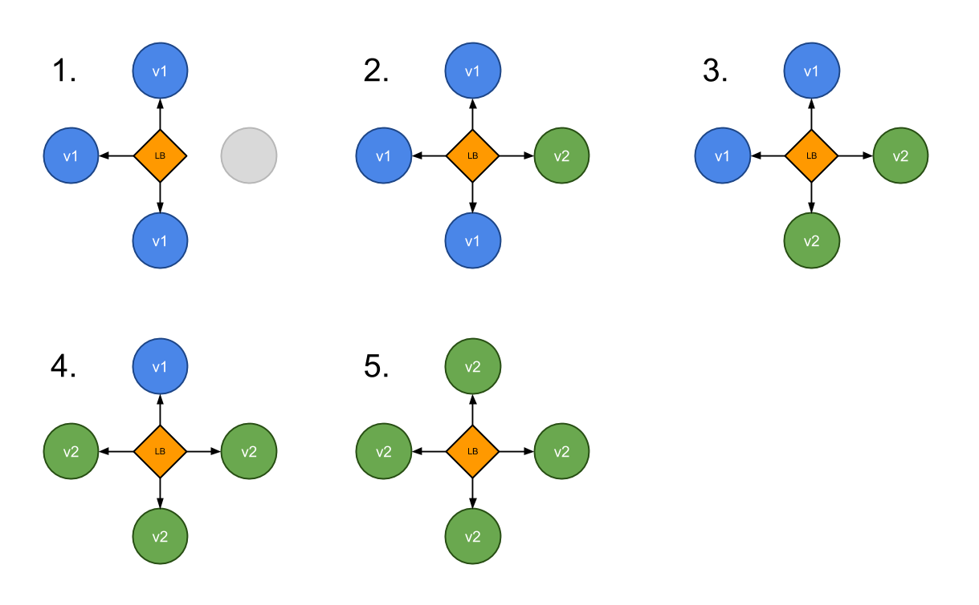
Rolling Update Deployment

Slide 27
Blue Green Deployment
A blue-green deployment is when you run two complete deployments of your application.
A deployment that is currently in production, and a deployment with the changes you want to introduce.
Have proxy or load balancer in front of your applications
Switch traffic to the new deployment when you are ready to take your changes into production.

Slide 28
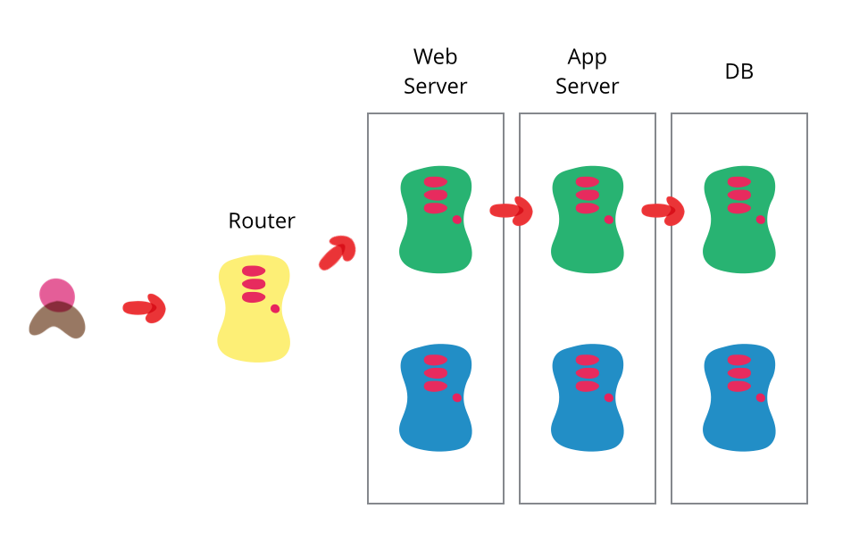
Blue Green Deployment
Source: https://martinfowler.com/bliki/BlueGreenDeployment.html

Slide 29
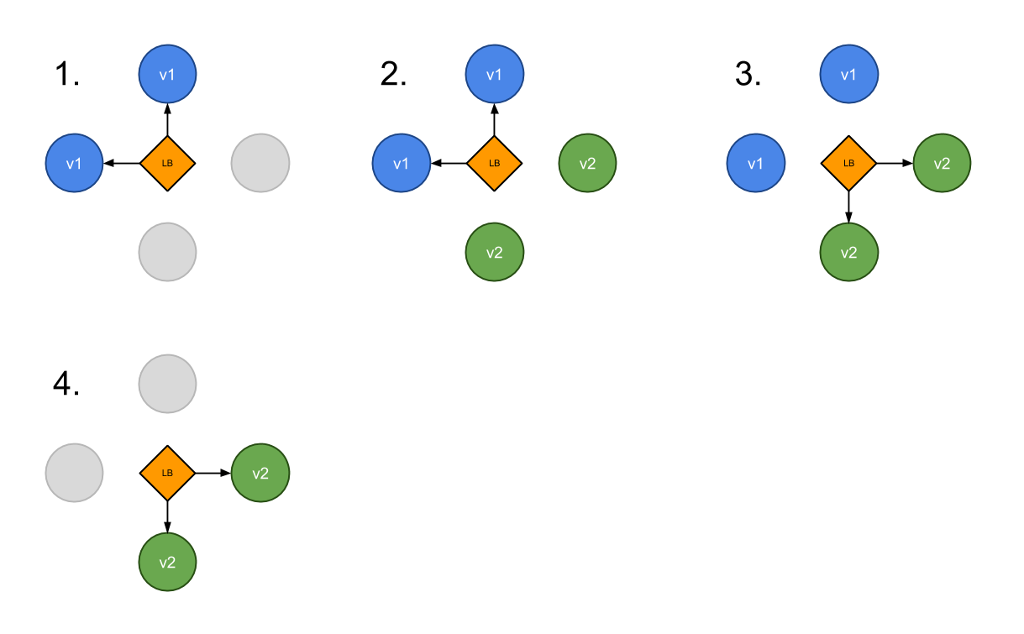
Blue Green Deployment

Slide 30
Canary Deployment
Canary deployment is when you run new version of the application next to the old one
Have proxy or load balancer in front of your applications
Some new applications are deployed next to the old ones
Part of the traffic is moved to the new application based on some rules – random, weight, cookie, http header etc.
Problem – client needs handle old and new application in the same time

Slide 31
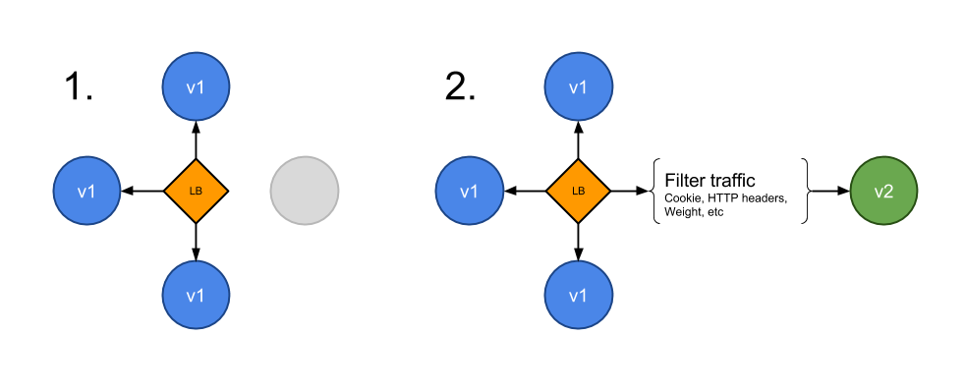
Canary Deployment

Slide 32

Rolling update deployment

Slide 33
Rolling Update Deployment
Deployment file:
apiVersion: extensions/v1beta1
kind: Deployment
metadata:
name: users-api-deployment
spec:
replicas: 1
strategy:
type: RollingUpdate
rollingUpdate:
maxUnavailable: 0
maxSurge: 1
template:
metadata:
labels:
app: users-api
spec:
containers:
- name: users-api
image: index.docker.io/mateuszdyminski/zero-java:v1
ports:
- containerPort: 8080
Rolling Update

Slide 34
maxUnavailable and maxSurge
maxUnavailable:
The number of pods that may be unavailable during the deployment. This is relative to the desired number, specified in replicas.
It can be either an absolute number or a percentage.
It should obviously be lower than the number of replicas, or no pods may remain available during the update.
maxSurge:
The (additional) number of pods that can be created, on top of the desired number of replicas.
This too can be either an absolute number or a percentage.
A higher number may speed up the deployment, but will also require more system resources.

Slide 35
Graceful Shutdown

Slide 36
Graceful Shutdown
We can speak about the graceful shutdown of our application, when all of the resources it used and all of the traffic and/or data processing what it handled are closed and released properly.
It means that no database connection remains open and no ongoing request fails because we stop our application.

Slide 37
Graceful Shutdown with Kubernetes
App receives SIGTERM signal because Kubernetes wants to stop it
App (pod) starts to return 500 for GET /health to let readinessProbe(Service) know that it's not ready to receive more requests.
Kubernetes readinessProbe checks GET /health and it stops redirecting traffic to the app (because it continuously returns 500)
App waits before it starts to shutdown - to make sure that the Service is getting notified via readinessProbe fail
App starts graceful shutdown
App first closes server with live working DB connections
App exits process
Kubernetes force kills the application after 30s (SIGKILL) if it's still running (in an optimal case it doesn't happen)

Slide 38
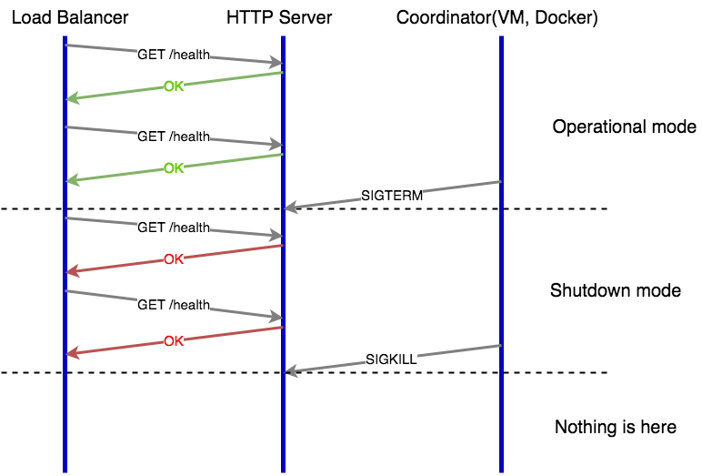
Web Server Graceful Shutdown

Slide 39
Blue Green Deployment

Slide 40
Blue Green Deployment

Slide 41
Users Service on Kubernetes
Service file:
apiVersion: v1
kind: Service
metadata:
name: users-api-bg
labels:
app: users-api
spec:
type: NodePort
ports:
- port: 8080
nodePort: 30002
selector:
app: users-api-blue
blue

Slide 42
Users Service on Kubernetes
Deployment file:
apiVersion: extensions/v1beta1
kind: Deployment
metadata:
name: users-api-deployment-bg
spec:
replicas: 1
template:
metadata:
labels:
app: users-api-blue
spec:
containers:
- name: users-api-blue
image: index.docker.io/mateuszdyminski/zero-java:v1
ports:
- containerPort: 8080
blue

Slide 43
Blue Green Deployment

Slide 44
Blue Green Deployment

Slide 45
Switch Environments from Blue to Green
Apply following changes into out main Service:
Then
apiVersion: v1
kind: Service
metadata:
name: users-api-bg
labels:
app: users-api
spec:
type: NodePort
ports:
- port: 8080
selector:
app: users-api-green
blue -> green
$ kubectl apply –f 04_bg_srv.yaml

Slide 46
Summary

Slide 47
Takeaways
Make sure your process receiving the termination signal.
Don’t use:
ENTRYPOINT java –jar /usr/share/zero/users-1.0.0.jar or
CMD java –jar /usr/share/zero/users-1.0.0.jar
Use:
ENTRYPOINT [ java”, “-jar”, “/usr/share/zero/users-1.0.0.jar ” ] or
CMD [ java”, “-jar”, “/usr/share/zero/users-1.0.0.jar ” ]
Add some grace period before closing the HTTP server to avoid failing requests.
It did not make any difference if the app failed it’s readiness probe after SIGTERM

Slide 48
A/B testing
Can be done via Canary Deployment

Slide 49

Release Phase

Slide 50
Release Process
Before Release:
Create Release Notes
Create Release Plan
Create Release Process

Slide 51
Release Process
Release notes:
Manual list
Take it from JIRA
Take it from git/svn - git log v1.0..v1.2
Use sections - New and Fixed

Slide 52
Release Process
Release plan:
When release the application (time, day)
What if something goes wrong? Revert?
Release Trains ?
Release Window ?
Continuos release ?

Slide 53
Release Process
Automate everything:
Ansible/Puppet/Chef/Salt*
Docker/Kubernetes/Swarm
Sometimes bash is good enough : )
Use process daemons - Does my app be up & running when node will be rebooted?

Slide 54
Chaos Engineering

Slide 55
Chaos Engineering
the discipline of experimenting on a distributed system in order to build confidence in the system's capability to withstand turbulent conditions in production.

Slide 56
Chaos Engineering
In 2010 The Netflix Eng Tools team created Chaos Monkey.
Chaos Engineering involves running thoughtful, planned experiments that teach us how our systems behave in the face of failure.
Chaos Engineering

Slide 57
Why would you break things on purpose?
Fallacies of Distributed Systems:
The network is reliable
Latency is zero
Bandwidth is infinite
The network is secure
Topology doesn't change
There is one administrator
Transport cost is zero
The network is homogeneous

Slide 58
Chaos Engineering – how?
Planning your First Experiment
Creating a Hypothesis
Measuring the Impact
Have a Rollback Plan
Go fix it!
Have Fun

Slide 59
Chaos Experiments to Start With
Simulating the failure of a micro-component and dependency.
Simulating a high CPU load and sudden increase in traffic.
Simulating failure of entire AZ(Availability Zone) or region.
Injecting latency and byzantine failures in services.
Exhausting memory on instances(cloud services) and allowing fault injection.
Causing Host Failure.

Slide 60
Chaos Engineering
Chaos Monkey
ChaosBlade
Gremlin
Chaos Mesh
Litmus
Chaos Toolkit
PowerfulSeal

Slide 61
Chaos Engineering - summary
Good but expensive to develop and test
It doesn't support all kinds of deployment.
You need to have great monitoring / tooling

Slide 62

Operations

Slide 63
Operations
Services Health
Log aggregators
Metrics/instrumentation
Distributed tracing
Alarms

Slide 64

Services Health

Slide 65


Slide 66
Do I really need Health Checks ?

Slide 67
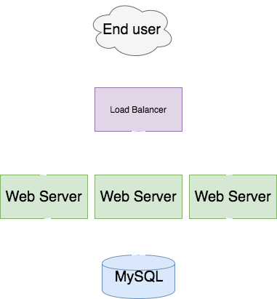

Slide 68
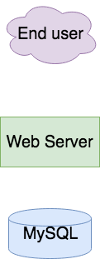
Do I need health checks in following architecture?

Slide 69
HealthZ
It leverage health endpoint pattern.
Historically comes from Google’s internal practices.
Adds many important information about the health of our service:
Deployed version
Uptime
Hostname
Git statistics
Health of external services - DB, Cache etc

Slide 70
Health Checks
Add AppStatus and Mongo client to Health REST controller:
Don’t forget about
@Path("api/health") public class ExtendedHealthResource { @Inject private GitRepositoryState gitRepositoryState; @Inject private MongoDatabase mongoDatabase; @Inject private AppStatus appStatus; @GET @Produces("application/json") public Response getHealth() { Document serverStatus = mongoDatabase.runCommand(new Document("serverStatus", 1)); return Response.ok().entity(new ExtendedHealthStatus(gitRepositoryState, serverStatus, appStatus)).build(); } }

Slide 71
Health Checks
AppStatus class:
Don’t forget about
public class AppStatus { private String hostname; private LocalDateTime startedAt; public AppStatus(String hostname, LocalDateTime startedAt) { this.hostname = hostname; startedAt = startedAt; } public String getHostname() { return hostname; } public String getStartedAt() { return StartedAt.toString(); } public String uptime() { return Duration.between(StartedAt , LocalDateTime.now()).toString(); } }

Slide 72
Services Health - Summary
Use HealthZ concept
It tells you not only if your server is up, but also if it’s really running
Look out for Load Balancers

Slide 73
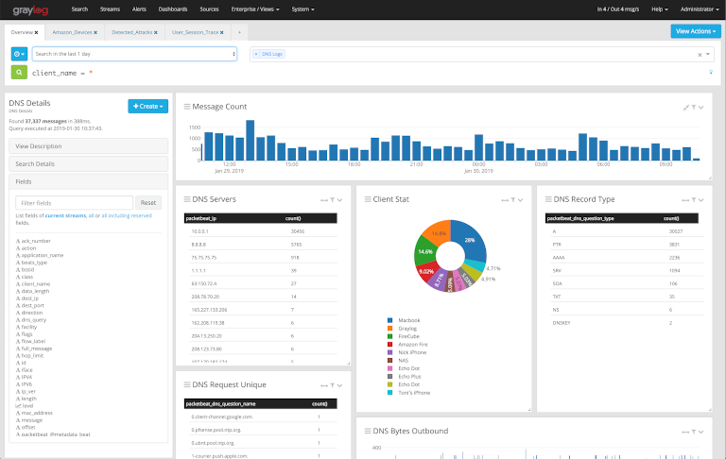
Log aggregators

Slide 74
Log aggregators
Single place where logs from all of the component, VM, services are send
No log aggregator = security hole
Usually contains log forwarder installed on each VM which sends them to aggregator

Slide 75
Log aggregators - options
Papertrail
Logstash
Graylog
Loggly
Sumo Logic
EFK –ElastiSearch, Fluend, Kibana

Slide 76
Logs – good practices
Log to standard output not to file
Use logs in standardized format – json etc.
Add context to your logs
Use proper level in logs
Sending error = wake up in the middle of night
Don’t send sensitive information
Password etc.

Slide 77
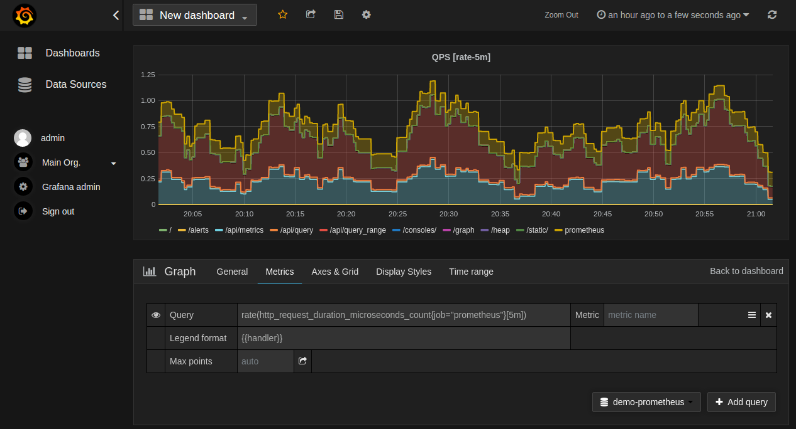
Metrics

Slide 78
Metrics/Instrumentation
In the context of computer programming, instrumentation refers to an ability to monitor or measure the level of a product's performance, to diagnose errors, and to write trace information.

Slide 79
What to instrument
The short answer is to instrument everything. Every library, subsystem and service should have at least a few metrics to give you a rough idea of how it is performing.

Slide 80
How to instrument
Instrumentation should be an integral part of your code. Instantiate the metric classes in the same file you use them. This makes going from alert to console to code easy when you are chasing an error.

Slide 81
Monitoring and Alarming
Monitoring should never require a human to interpret any part of the alerting domain
Three valid kinds of monitoring output
Alerts: human needs to take action immediately
Tickets: human needs to take action eventually
Logging: no action needed

Slide 82
Monitoring and Alarming
Eliminating toil - Carla Geisser:
“If a human operator needs to touch your system during normal operations, you have a bug. The definition of normal changes as your systems grow.”
If you have to ssh to your server to do some work - something is wrong
Automate backups
Automate logs rotating - send old ones to S3/equivalent

Slide 83
Monitoring and Alarming
Measure everything
Set alerts based on the metrics
Analytics can use your metrics!

Slide 84
Monitoring and Alarming
Key things to measure
Java GC metrics
Http code rates
Http response time percentiles - 50, 95, 99
Error logs
Uptime
Business metrics
IPC(instructions per cycle) over CPU - CPU utilization is wrong

Slide 85
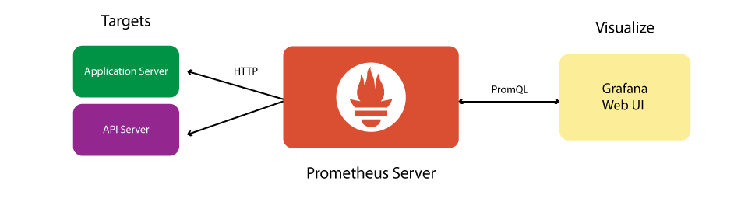
Prometheus flow

Slide 86
How to instrument
import (
"github.com/prometheus/client_golang/prometheus/promhttp"
)
func main() {
mux := http.NewServeMux()
// prometheus handler
mux.Handle("/metrics", promhttp.Handler())
// our business logic handlers
mux.HandleFunc("/hello", hello)
inst := prom.NewInstrument()
srv := &http.Server{
Addr: ":8095",
Handler: inst.Wrap(mux),
}
if err := srv.ListenAndServe(); err != nil {
log.Fatal().Msgf("HTTP server failed: %v", err)
}
}

Slide 87
How to instrument
func NewInstrument() *Instrument {
// used for monitoring and alerting (RED method)
histogram := prometheus.NewHistogramVec(prometheus.HistogramOpts{
Subsystem: "http",
Name: "request_duration_seconds",
Help: "Seconds spent serving HTTP requests.",
Buckets: prometheus.DefBuckets,
}, []string{"method", "path", "status"})
prometheus.MustRegister(histogram)
return &Instrument{
Histogram: histogram,
}
}

Slide 88
Metrics – pros vs cons
Almost no cons
Highly recommended to all types of systems and architectures
Instrumentation available in all languages
Measure everything!
Really useful for business
Realtime reports

Slide 89

Distributed tracing

Slide 90
Distributed tracing
Track and observe service requests as they flow through distributed systems by collecting data as the requests go from one service to another.

Slide 91
Distributed tracing - features
Visualize request flow and service dependencies
Track service health metrics—rate, error and duration (RED)
Deep-dive into individual traces to pinpoint any performance bottlenecks
Discover architecture of the whole system via data-driven dependency diagram.

Slide 92
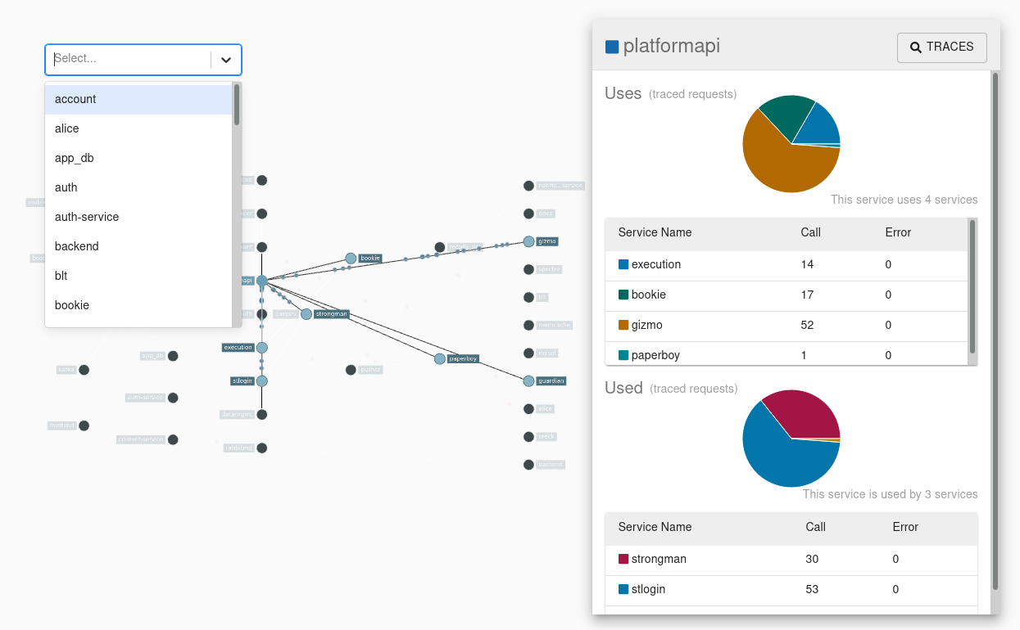
Distributed tracing – services visualization

Slide 93
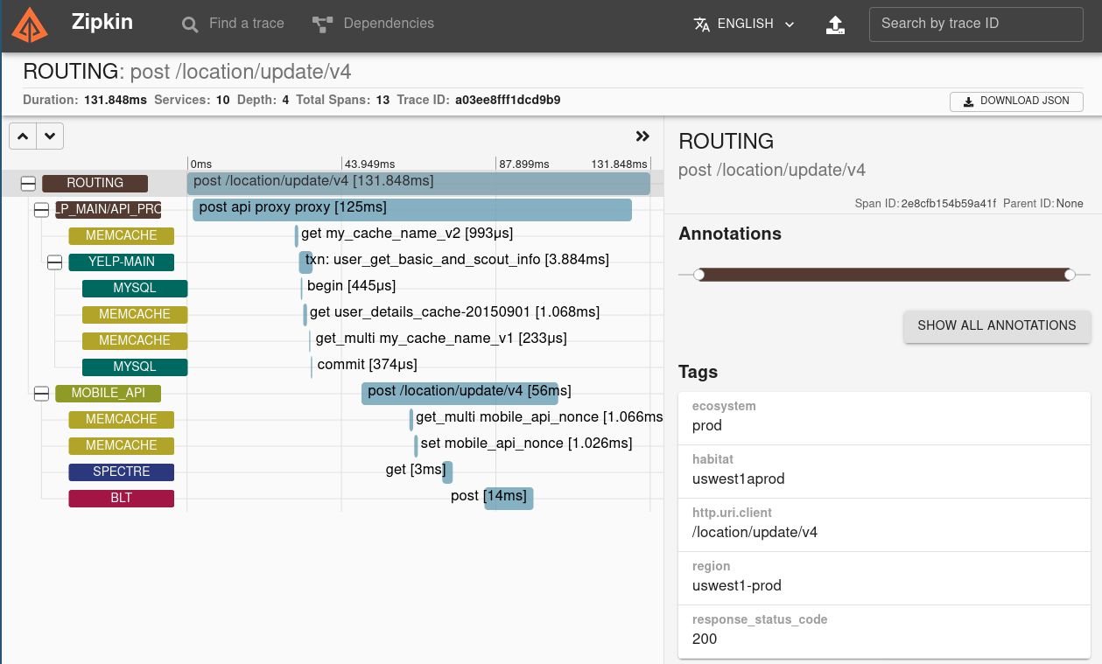
Distributed tracing – tracing

Slide 94
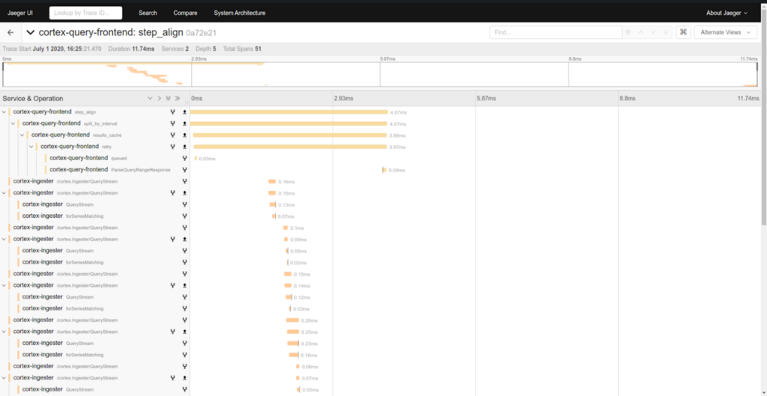
Distributed tracing – tracing

Slide 95
Distributed tracing - tools
Jaeger
Zipkin
Lightstep
NewRelic
Splunk
Datadog
…

Slide 96
Distributed tracing - pros
Easy to identify latency bottlenecks
Great tool for visualization of the flow and architecture
Easy to integrate with Service Mesh

Slide 97
Distributed tracing - cons
Another tool to learn
Another tool to maintain
Performance overhead
Only for microservices architecture

Slide 98

Security patterns and tools

Slide 99
IAM solutions
IAM = Identity and Access Management
Golden rule of security = newer write security tools by yourself
If it’s possible use – one the available tools
Use IDaaS(Identity as a service) over on-premise solutions

Slide 100
IAM tool - features
Manage user identities
Provisioning/deprovisioning users
Authenticating users
Authorizing users
Reporting
Single Sign-On

Slide 101
IAM solutions
Auth0
Azure Active Directory
CyberArk
Okta
SecureAuth
Keycloak
AWS IAM

Slide 102
IAM solutions – pros and cons
No cons, maybe performance
Follow golden rule of security = newer write security tools by yourself
Removes problems with users/roles management
SSO for free

Slide 103
Secrets/passwords management
Secrets engines are components which store, generate, or encrypt data.
Encryption as a Service
It helps organizations manage access to secrets and transmit them safely within an organization
Golden rule of security = newer write security tools by yourself

Slide 104
Secrets/passwords management
Problem:
Most applications need access to sensitive data in order to work. For instance, an application may have a username/password configured somewhere in order to connect to its database.
Database credentials and API Keys are some examples of sensitive information that we need to store and make available to our applications in a secure way.

Slide 105
Secrets/passwords management
Problem:
A simple solution is to store those credentials in a configuration file and read them at startup time.
Whoever has access to this file share the same database privileges our application have – usually giving her full access to all stored data.
Modern applications and cloud environments tend to add some extra complexity: distributed services, multiple databases, messaging systems and so on, all have sensitive information, thus increasing the risk of a security breach.

Slide 106


Slide 107
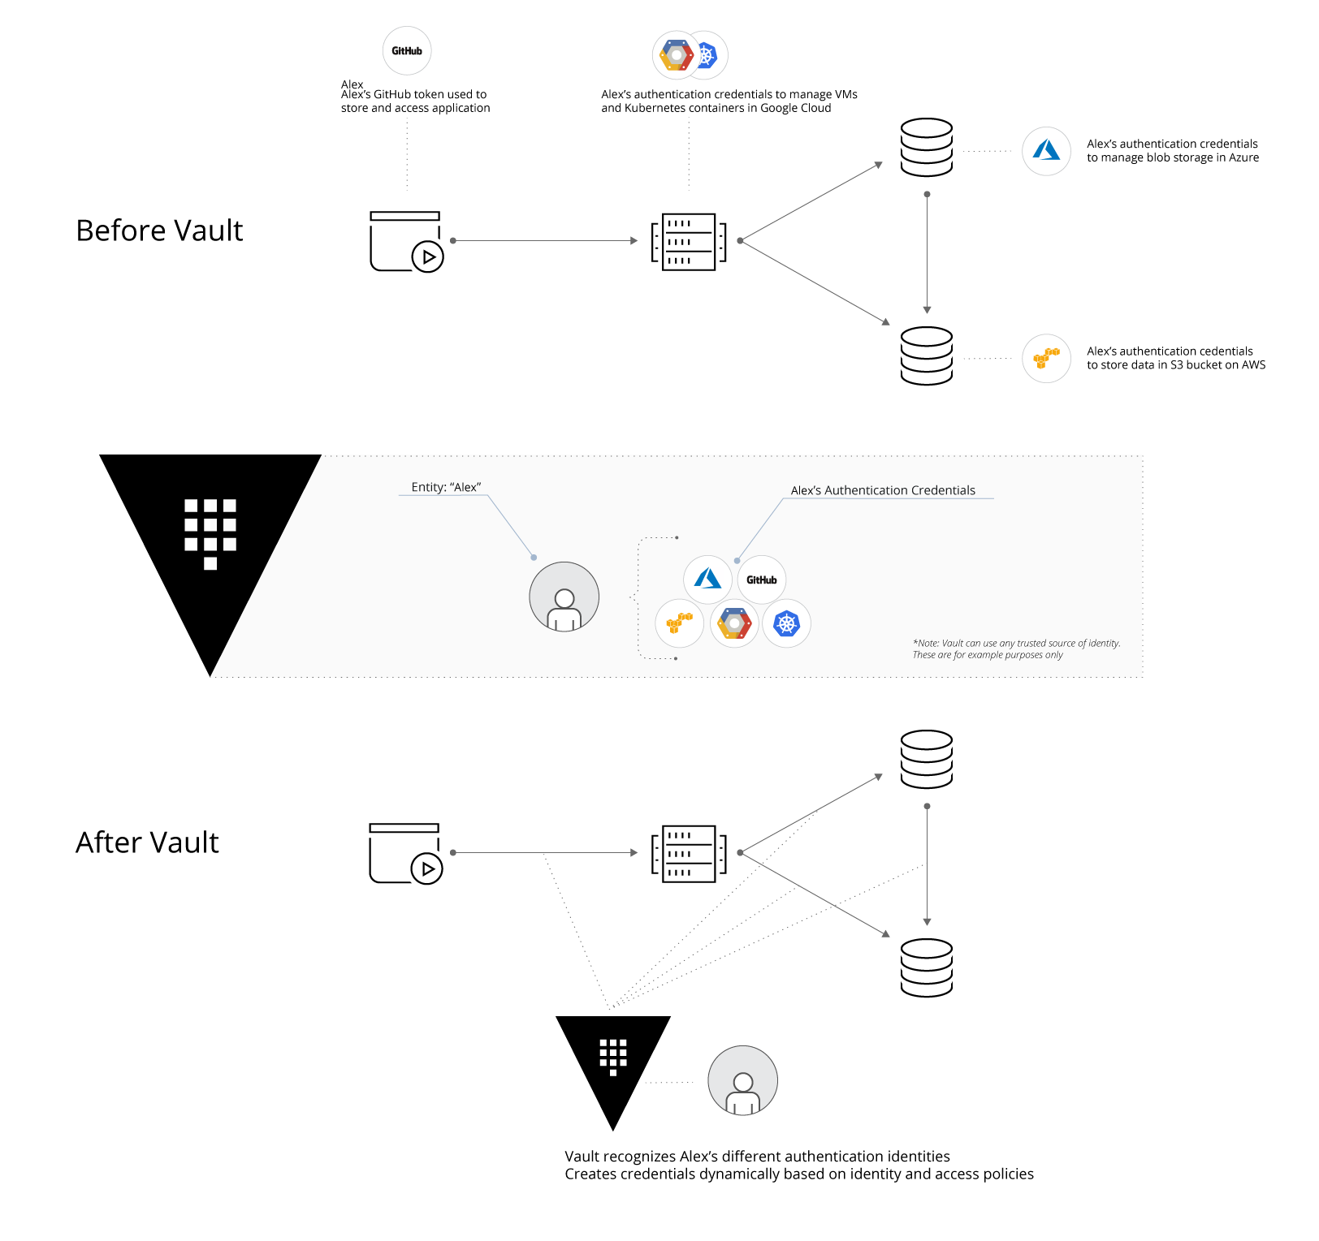

Slide 108
Vault
Vault's architecture is deceivingly simple. Its main components are:
A persistence backend – storage for all secrets
An API server which handles client requests and performs operations on secrets
A number of secret engines, one for each type of supported secret type

Slide 109
Vault
By delegating all secret handling to Vault, we can mitigate some security issues:
Our applications don't have to store them anymore – just ask Vault when needed and discard it
We can use short-lived secrets, thus limiting the “window of opportunity” where an attacker can use a stolen secret
To access secrets in Vault a client needs to authenticate itself using one of the supported methods. The simplest method uses Tokens, which are just strings sent on every API request using a special HTTP header.

Slide 110
Secrets/passwords management – pros and cons
Remove all passwords from configurations
Reduce security holes in the system
Allow to regenerate passwords to systems more often
One cons – add another complexity to our system

Slide 111
Code scanning
Source code analysis tools, also known as Static Application Security Testing (SAST) Tools, can help analyze source code or compiled versions of code to help find security flaws.
SAST tools can be added into your IDE.
SAST tools can be added to CI
List of available tools: https://owasp.org/www-community/Source_Code_Analysis_Tools

Slide 112
Code scanning - pros
Scales well – can be run on lots of software, and can be run repeatedly (as with nightly builds or continuous integration).
Identifies certain well-known vulnerabilities, such as:
Buffer overflows
SQL injection flaws
Output helps developers, as SAST tools highlight the problematic code, by filename, location, line number, and even the affected code snippet.

Slide 113
Code scanning - cons
Difficult to automate searches for many types of security vulnerabilities, including:
Authentication problems
Access control issues
Insecure use of cryptography Current SAST tools are limited. They can automatically identify only a relatively small percentage of application security flaws.
High numbers of false positives.
Frequently unable to find configuration issues, since they are not represented in the code.
Difficult to ‘prove’ that an identified security issue is an actual vulnerability.
Many SAST tools have difficulty analyzing code that can’t be compiled.
Analysts frequently cannot compile code unless they have:
Correct libraries
Compilation instructions
All required code

Slide 114
Containers scanning
Tool for containers security scanning
Easy to attach to CI
Find most of the CVE as OS level
Find most of the CVE in programming language
Find most of the CVE in app dependencies

Slide 115
Containers scanning – how?

Slide 116
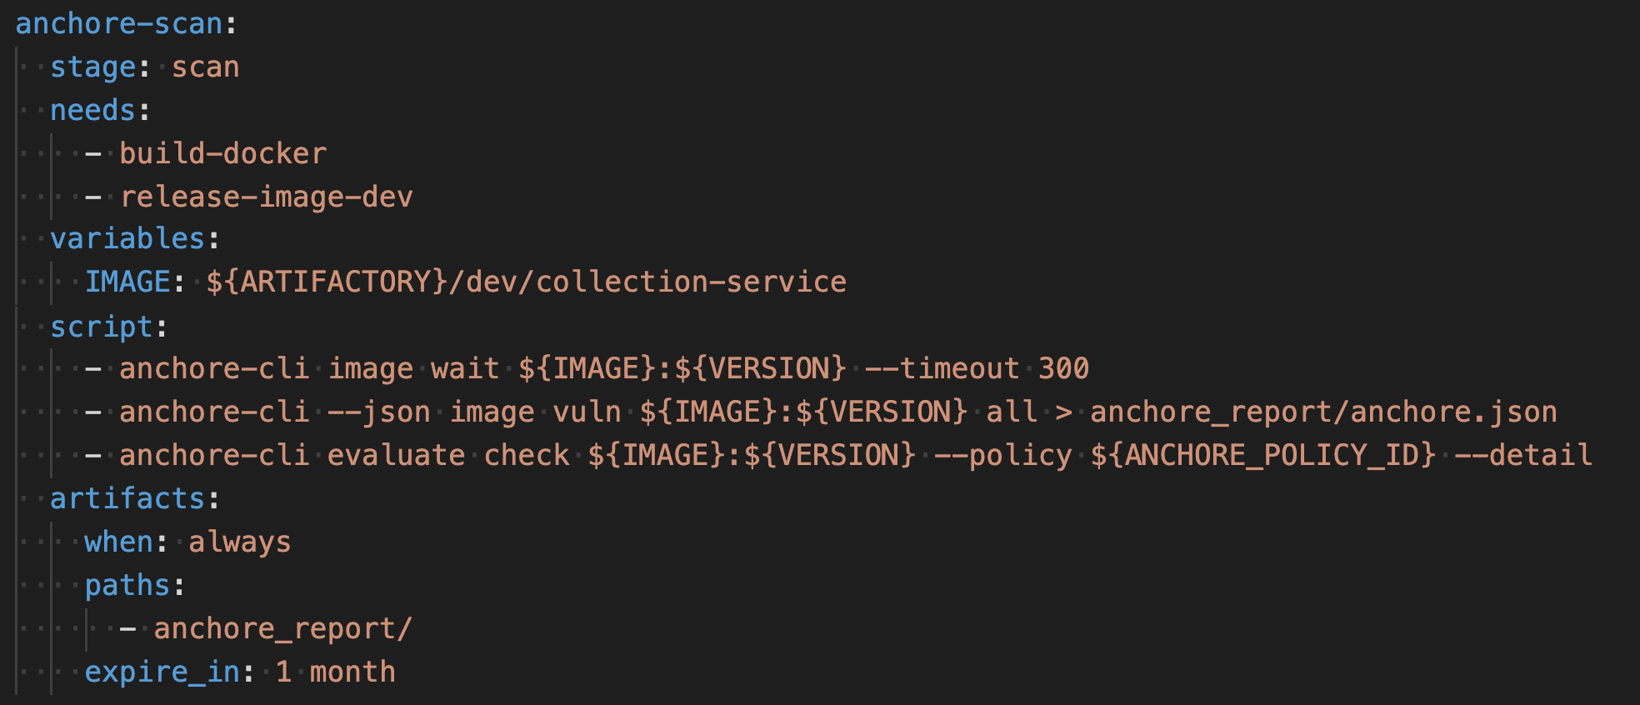
Containers scanning – how?

Slide 117
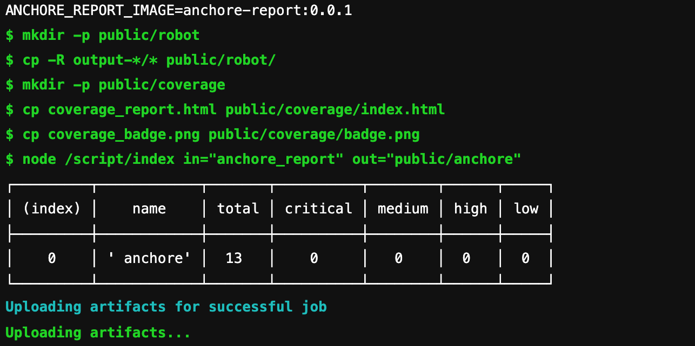
Containers scanning – how?

Slide 118
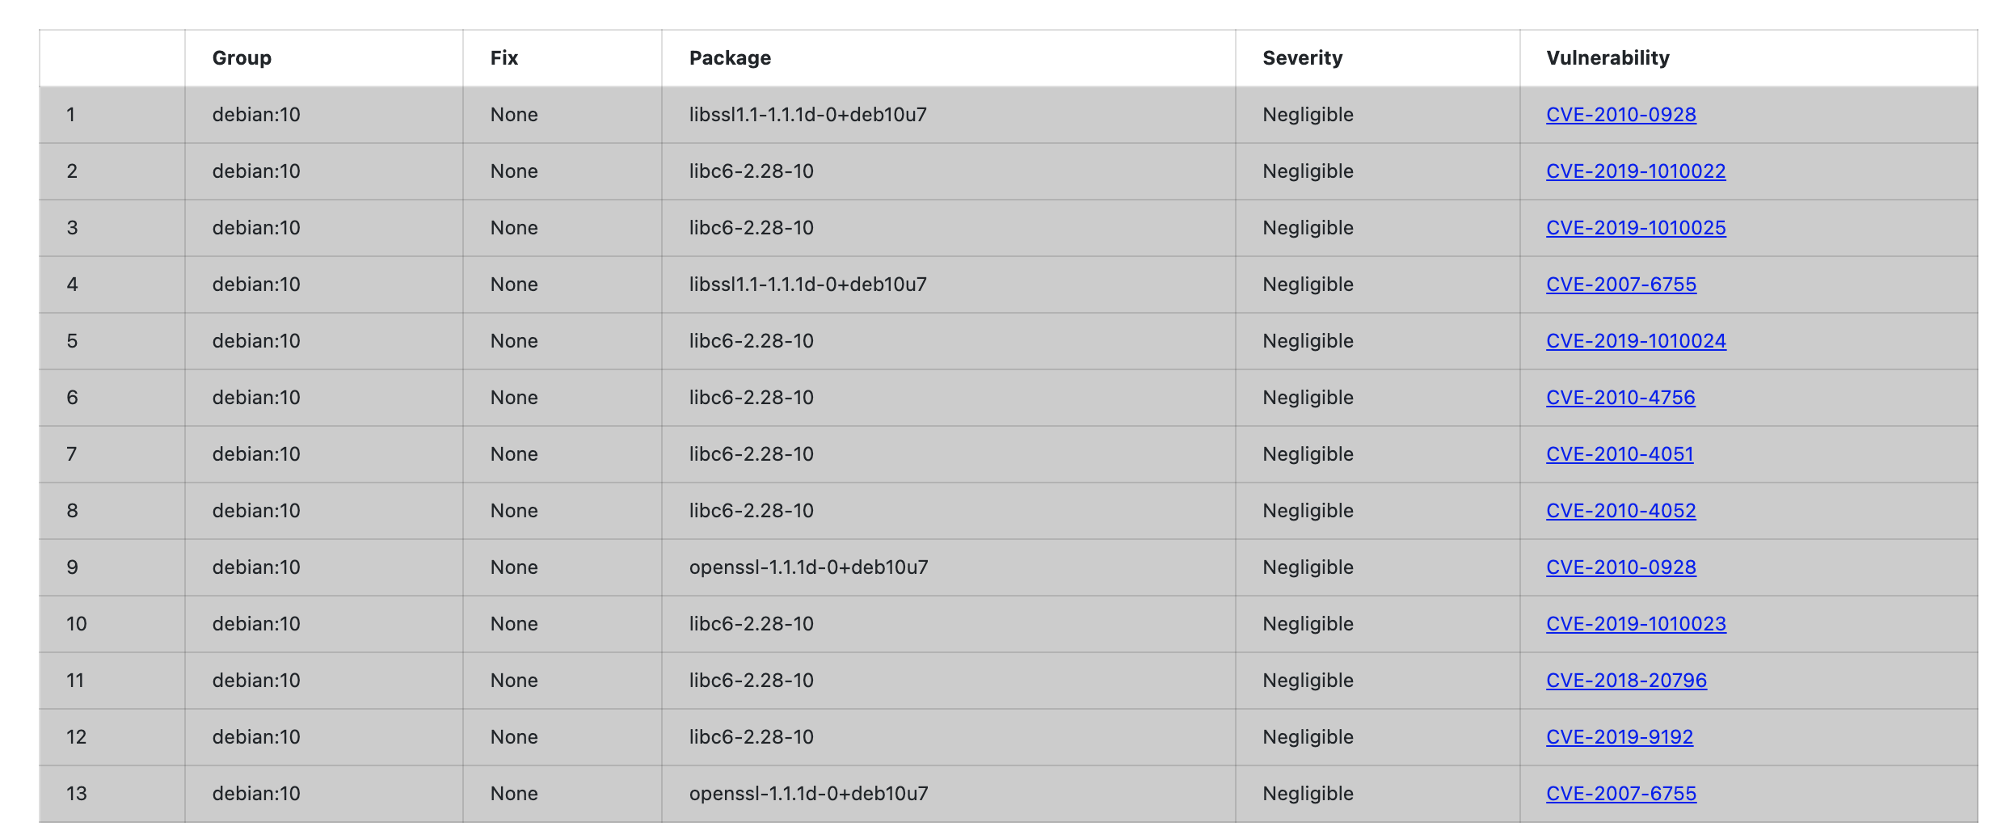
Containers scanning – how?

Slide 119
Containers scanning - tools
Anchore
Clair
Dagda
Falco
Harbor
Docker Bench

Slide 120
Containers scanning – pros and cons
Only pros
Use it always

Slide 121

Q&A

Slide 122

Please fulfil survey: https://plbe.nobleprog.com/tf/126719

